Slide 1

FOCUS PRIORITIES: 2016-2017:
WE ARE CLARE MOUNT ..
WE ARE OUTSTANDING.
FP1 – To ensure school development plans set out more clearly what the intended targets for improvement are and how success can be more easily measured along the way (Ofsted 2016).
FP2 – To continue to support and improve the literacy and numeracy needs of pupils across the whole school to prepare them for life beyond school.
FP3 – To maintain and develop best practice in meeting the needs of all pupils in order to renew our ASC Accreditation Award in 2017.
FP4 – To further develop partnerships, as well as excellence in teaching and professional development, as a basis for successfully applying to become a Teaching School by 2018.

Slide 2


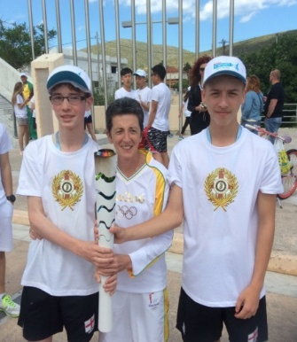
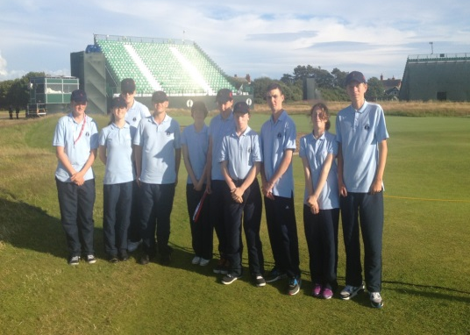
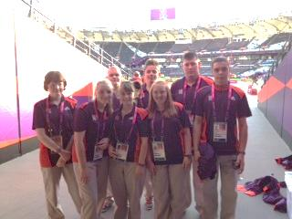
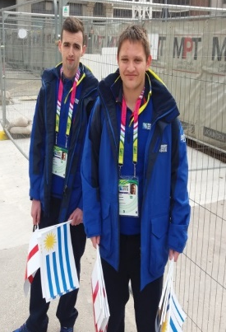
OUR VISION
BE MORE ASPIRATIONAL: “YES I CAN”
In keeping with the Paralympic Games we want our pupils to be:
“ROLE MODELS & CATALYSTS FOR CHANGE”
RUGBY WORLD CUP, 2015
GAMES MAKERS, 2012
ENGLAND SPECIAL OLYMPICS, GREECE 2016
JUNIOR GOLF SUPERVISORS, 2014
Notes:
String of Awards

